Slide 1
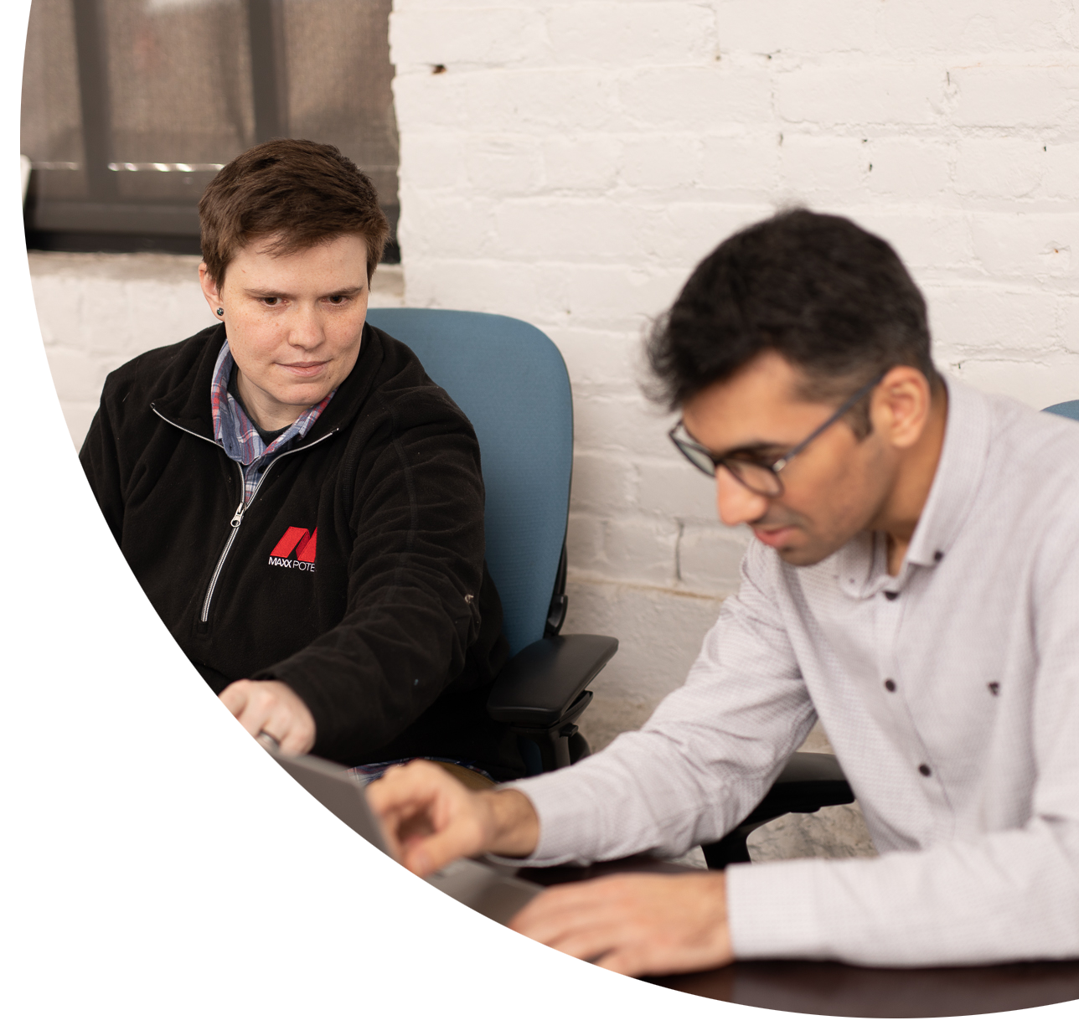


Defending Against the Deep
Is your workforce ready
for Generative AI Adversaries?
June 4, 2024

Slide 2
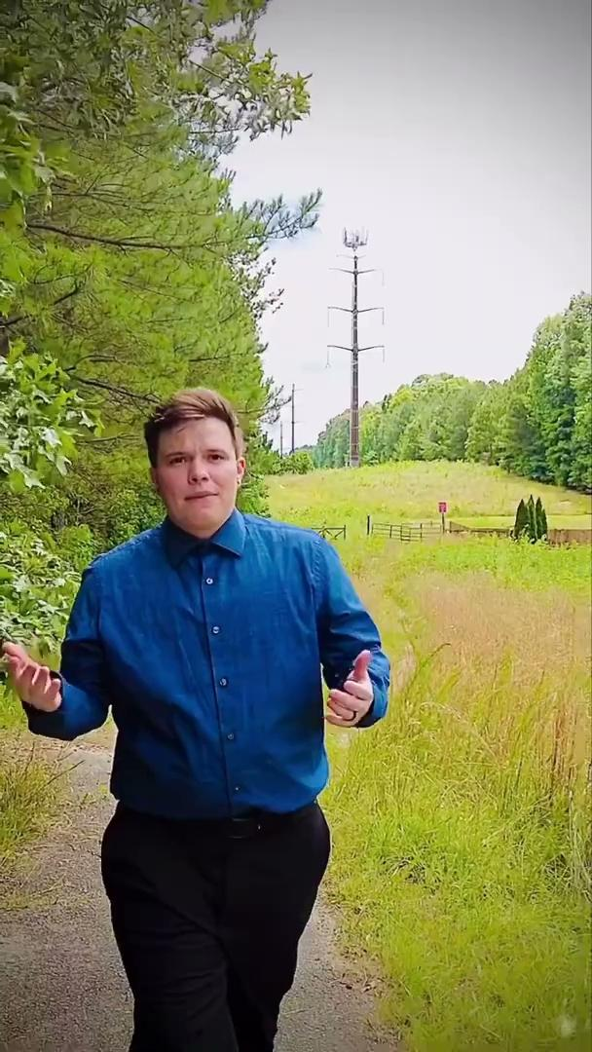

Tucker Mahan
VCU, BSc Sociology, minor in Math & Religious Studies
MicroMasters Data Analytics
MAXX Potential, 2015
Emerging Technology
Many Community Volunteer Roles

Slide 3
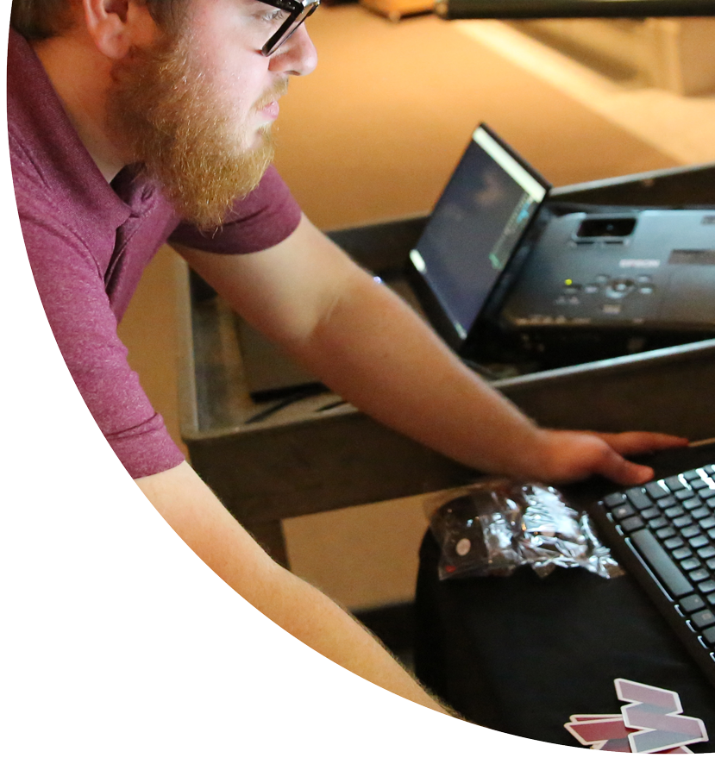


Agenda
Overview of AI Generated Media
Human or AI?
Technical Demo
Video
Voice
Translation
Limitations
Empowering Your Workforce
Q&A

Slide 4
Overview of AI Generated Media
AI: Computer science focused on creating systems capable of performing tasks that typically require human intelligence
AI Generated Media: Content created with the assistance of AI technologies
Includes multi-modality:
text
images
audio
video

Slide 5
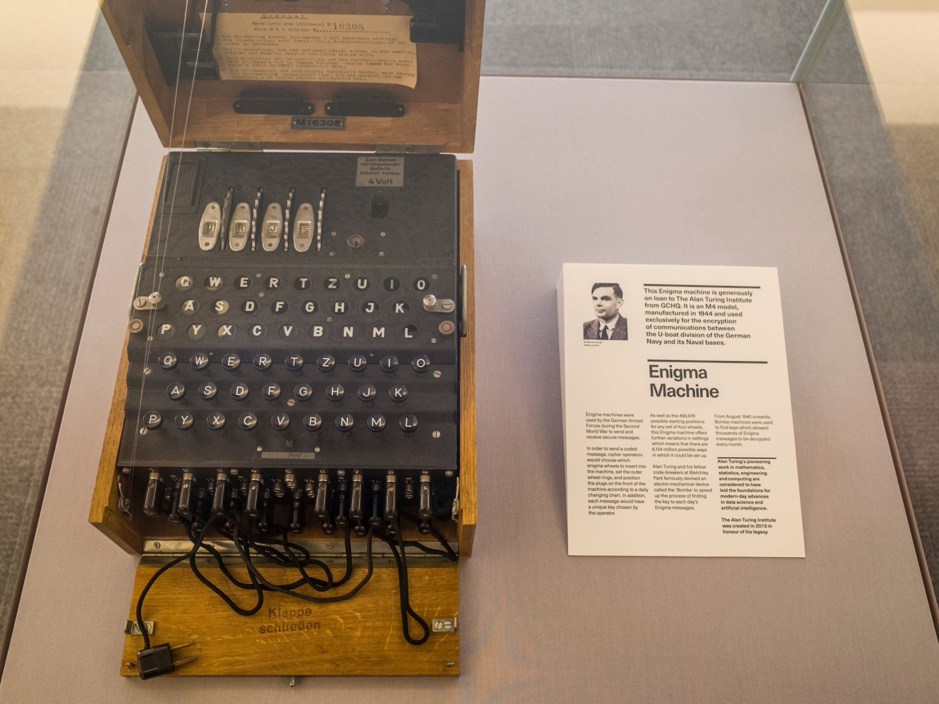
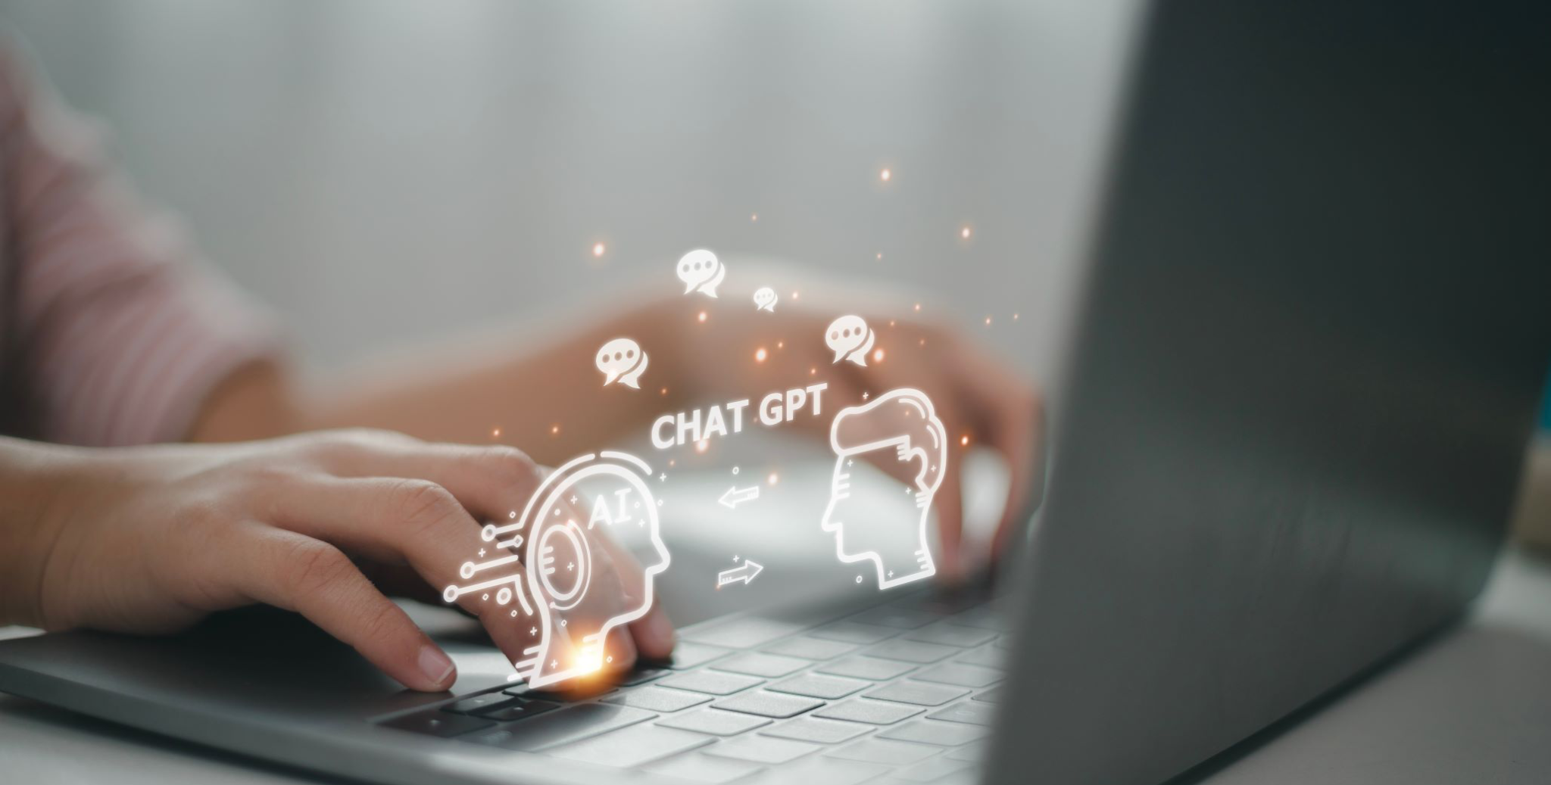
From Turing to AI Everywhere
1940s-1960s: Turing & ELIZA Chatbot
1980s-2010s: RNN; LSTM; GAN; VAE
2017: Transformer Architecture & GPT

Slide 6
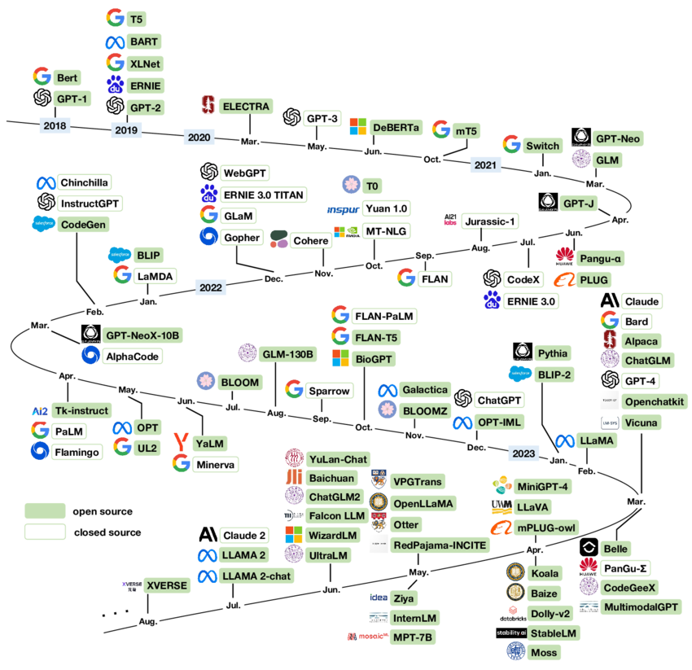
AI Everywhere
Acceleration of Advancements
Competition for Market Share
GenAI becoming Table Stakes
SaaS Products
Resumes
You won’t be replaced by AI, but likely by someone using AI

Slide 7

“90% of the internet will be AI by 2025 or 2026!”

Slide 8
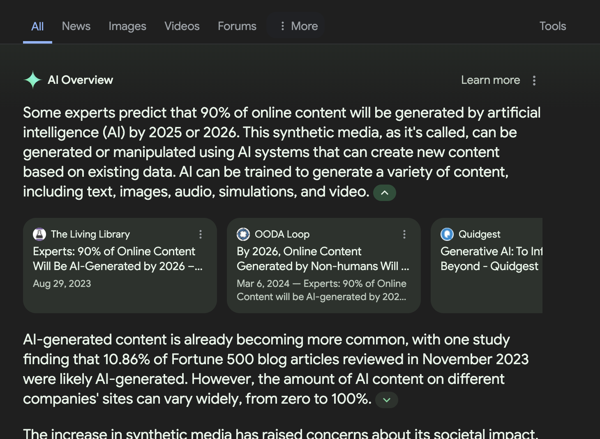
“Some experts predict that as much as 90 percent of online content could be synthetically generated within a few years.”

Slide 9

AI increasing, so what?
85% of workers believe AI has made cybersecurity attacks more sophisticated
39% of workers are not confident that they know how to use AI responsibly
Google Warning: Effectiveness and Scale of Social Engineering & Phishing Attacks to Grow
91% of employees say organizations should regularly update their training to keep pace with AI

Slide 10
Recent Attacks
Believable AI Video Generation
Customized Phishing/Smishing/Vishing attacks

Slide 11
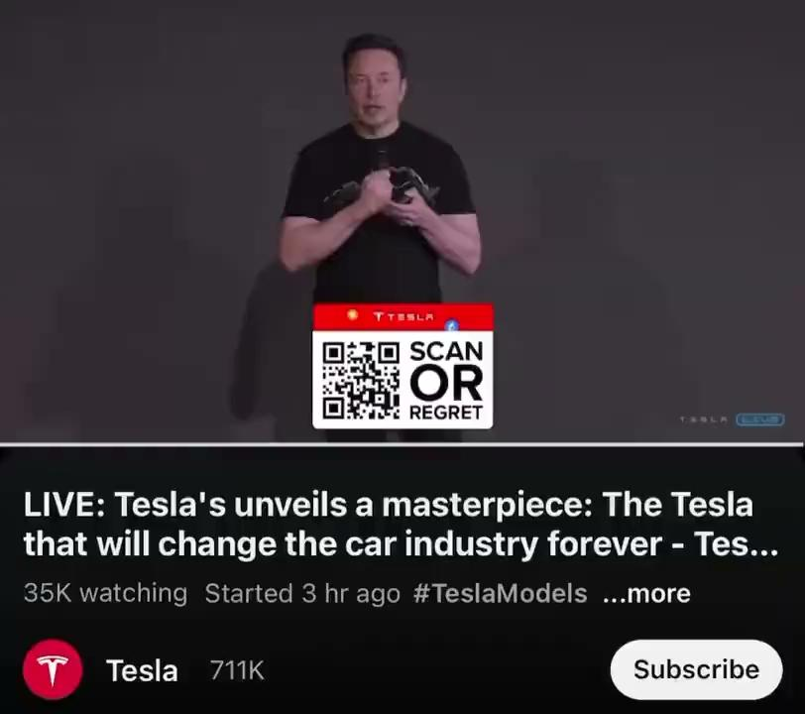
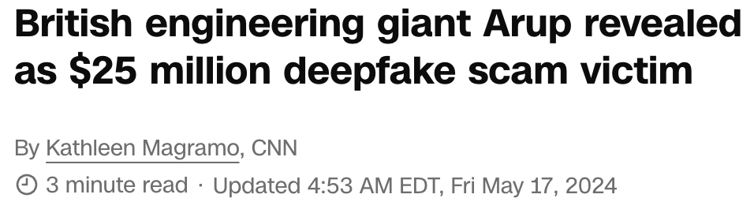
Generative AI Adversaries

Slide 12
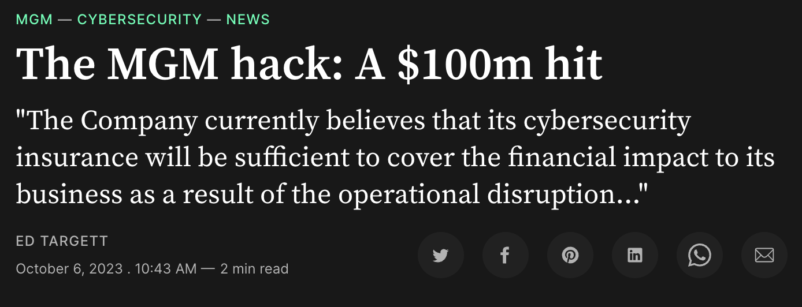
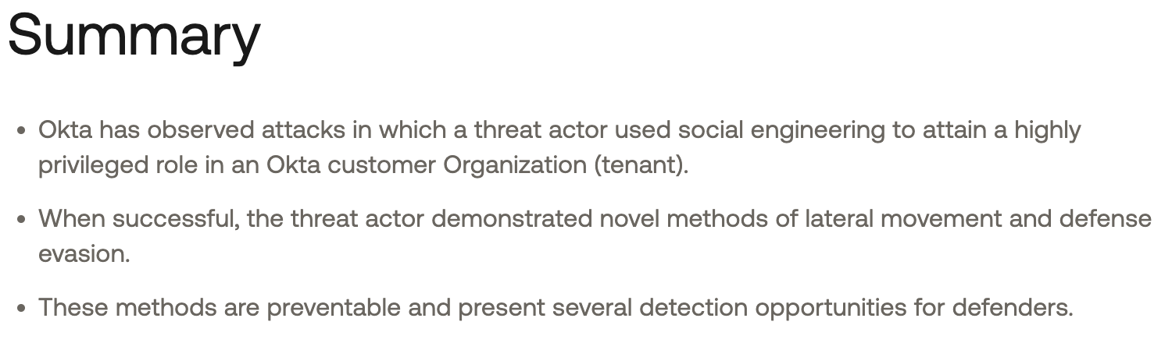
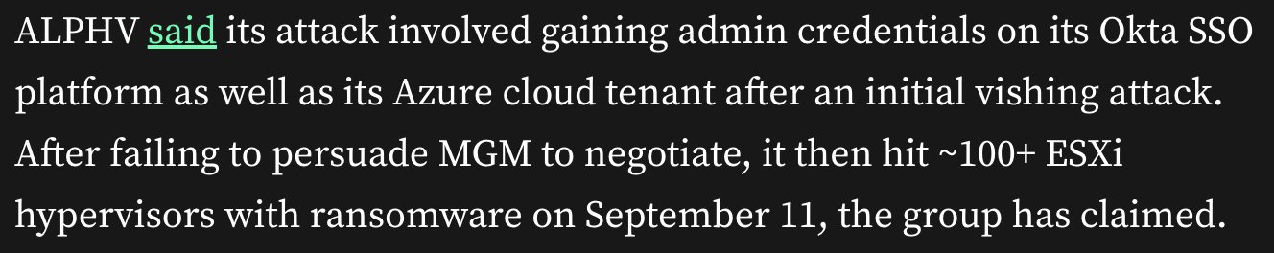
Generative AI Adversaries

Slide 13
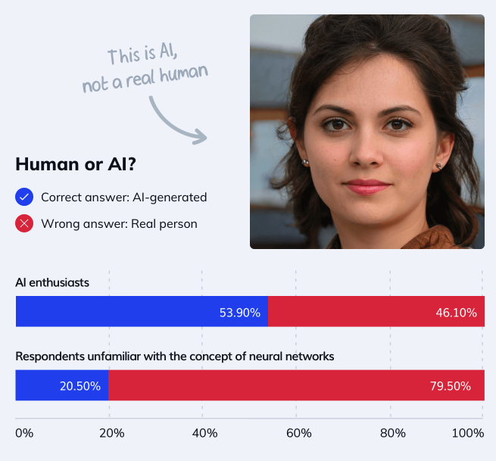
Overview of AI Generated Media
Understanding AI-generated media is essential in cybersecurity to:
detect deep fakes and synthetic media
ensure information integrity and trust
secure authentication methods
train security teams
develop advanced forensic techniques
accelerate internal processes

Slide 14
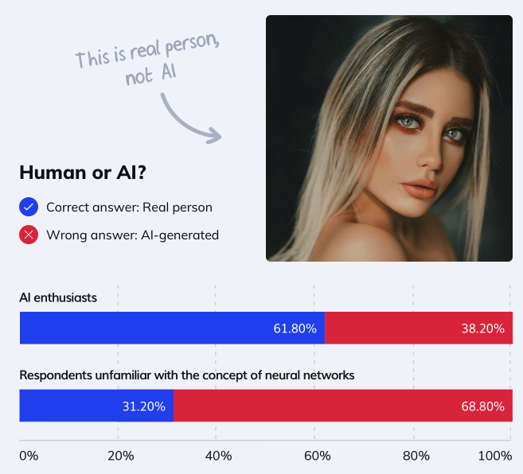
Overview of AI Generated Media
Understanding AI-generated media is essential in cybersecurity to:
detect deep fakes and synthetic media
ensure information integrity and trust
secure authentication methods
train security teams
develop advanced forensic techniques
accelerate internal processes

Slide 15
Real or AI?
How many can you correctly identify?
Join at slido.com
#4234121

Slide 16
Question 1 (Text):
A
A vulnerability is any weakness in an application, whether from design flaws or bugs. These vulnerabilities can let attackers harm anyone associated with the app, including owners, users, and other stakeholders. Please don’t post specific details about vulnerabilities in products, services, or web apps here. Report these issues on platforms like the bugtraq or full-disclosure mailing lists instead.
B
A vulnerability is a hole or a weakness in the application, which can be a design flaw or an implementation bug, that allows an attacker to cause harm to the stakeholders of an application. Stakeholders include the application owner, application users, and other entities that rely on the application.
Please do not post any actual vulnerabilities in products, services, or web applications. Those disclosure reports should be posted to bugtraq or full-disclosure mailing lists.

Slide 17
Question 1 (Text)
A
A vulnerability is any weakness in an application, whether from design flaws or bugs. These vulnerabilities can let attackers harm anyone associated with the app, including owners, users, and other stakeholders.
Please don’t post specific details about vulnerabilities in products, services, or web apps here. Report these issues on platforms like the bugtraq or full-disclosure mailing lists instead.
Text Challenges
AI Detectors
Search

Slide 18
Question 2 (Text):
A
User: My MacBook Pro has been running significantly slower than usual, especially when I'm using the energy modeling software. Can you help improve its performance? Support: Real Response User: I followed your instructions and found that the energy modeling software is using a lot of CPU and memory. What should I do next?
B
User: There’s a known Error happening with laptops using windows 11. Each user facing this problem has shown 11+optional updates queued in the Windows Update Screen.
Support: Real Response
User: Thank you [name]! We’ve solved the problem by launching Lenovo Commercial Vantage, clicking device, clicking smart assist, and switching auto lock off

Slide 19
Question 2 (Text)
A
User: My MacBook Pro has been running significantly slower than usual, especially when I'm using the energy modeling software. Can you help improve its performance? Support: Real Response User: I followed your instructions and found that the energy modeling software is using a lot of CPU and memory. What should I do next?
Text Challenges
Is your ticket queue spam proof?

Slide 20


Question 3 (Image):
A
A B
B

Slide 21
Question 3 (Image)
Teeth
Eyes
Hair Line
?
B

Slide 22


Question 4 (Image):
A
A B
B

Slide 23
Question 4 (Image)
Splotch
Ear / Hair Physics
Uncanny Smile Lines
?
B

Slide 24
Image Detection
Inconsistent Details
Lighting/Shadows
Distorted Features
Repetitive Patterns
Metadata
Edge/Boundaries
Context
Artifacts

Slide 25

Question 5 (Audio):
A
B

Slide 26
Question 5 (Audio)
Name pronunciation
Deeper than my standard
A!

Slide 27
Audio Detection
Emphasis
Pitch
Pauses
Accent
Human Interactions
Artifacts
Inconsistency
Background Noise*
Metadata
Anomalies

Slide 28
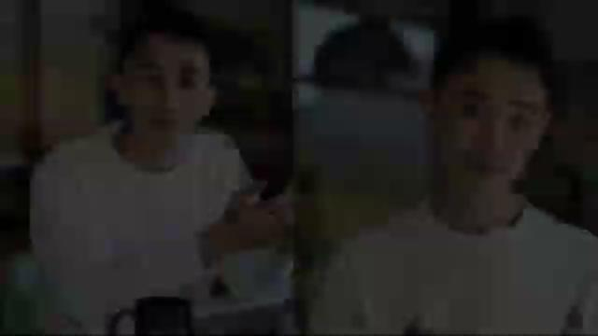
Question 6 (Video):

Slide 29
Question 6 (Video)
Gestures & Speech don’t align
Repetition
Both!

Slide 30
Video Detection
Inconsistent Motion
Unnatural Movement
Lighting
Lip Sync*
Unrealistic Textures
Metadata
Realistic Interaction
Context
Artifacts

Slide 31
Demos
Video
Voice
Translation
Limitations

Slide 32




















Technical Demo: Video

Slide 33
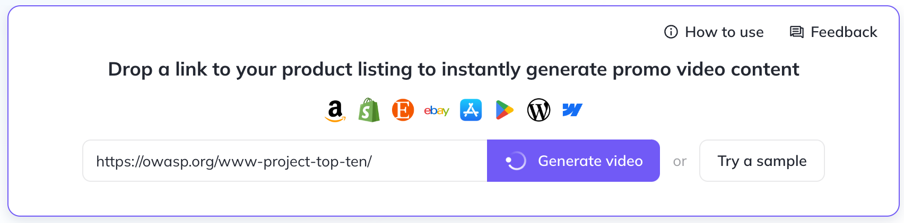
Technical Demo: Video

Slide 34

Technical Demo: Video

Slide 35
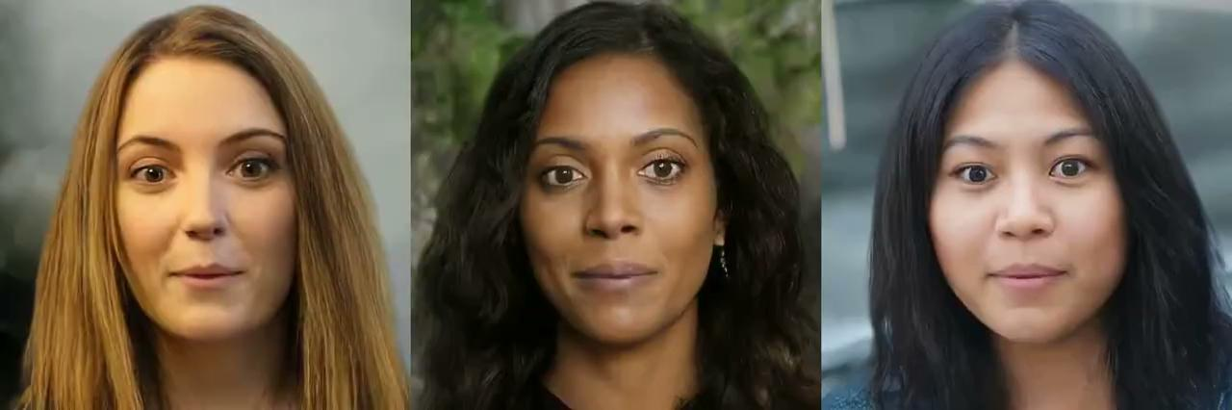
Technical Demo: Video

Slide 36












Technical Demo: Audio
Video Tools +

Slide 37
Technical Demo: Translations & Dubbing
Many options, including most of the above Video/Audio Tools
Shift from 2 → 1 Step
Breaking Language Barriers rapidly
Accessibility vs Trust conversation

Slide 38
Technical Demo: Limitations
Length of Content
Quality of Input
Data Privacy
Resource Intensiveness

Slide 39
Empowering Your Workforce

Slide 40
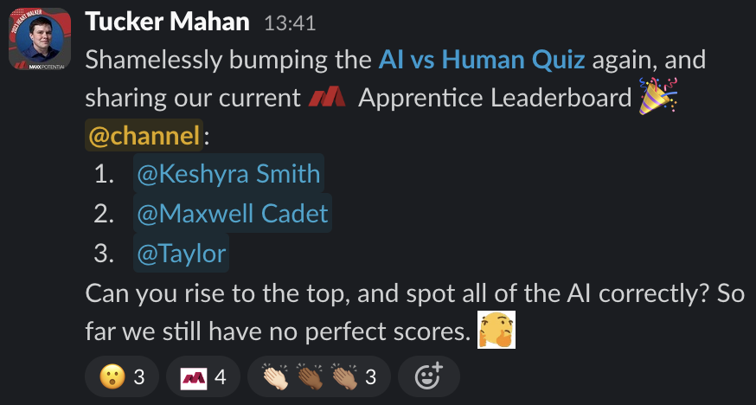
Empowering Your Workforce
AI Awareness
Easy to create & advance content
Gamifying Learning
Continuous Learning & Adaptation
Not replaced by AI, but by those using AI
“Systemize the predictable so you can humanize the exceptional!” - Gino Wickman
Balance Demonstrations with Hands On Experience
Provide access to hands on experience, and demonstration of responsible use

Slide 41
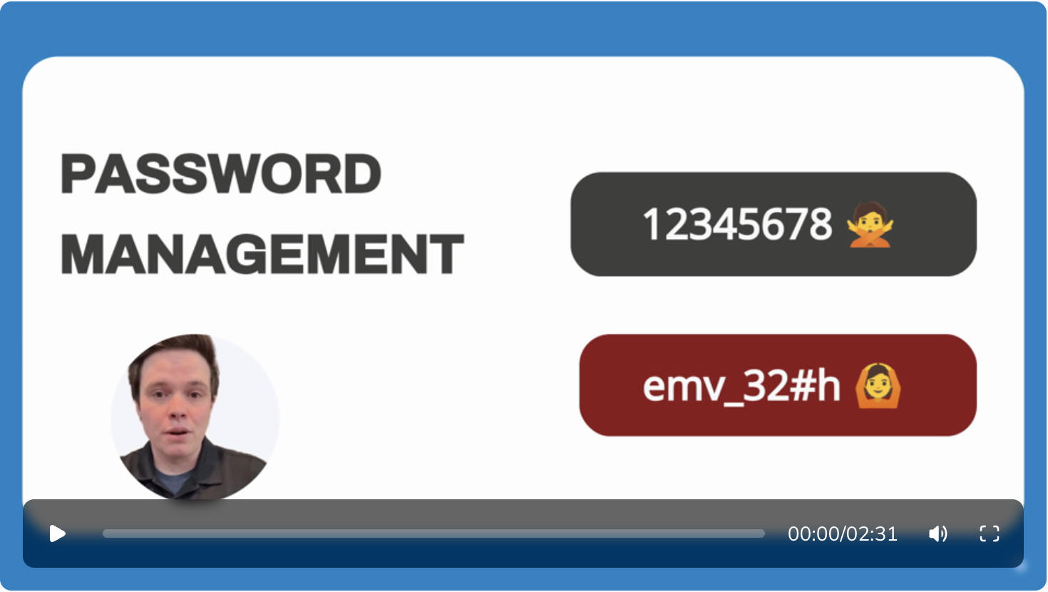
Empowering Your Workforce
AI Awareness
Easy to create & advance content
Gamifying Learning
Continuous Learning & Adaptation
Not replaced by AI, but by those using AI
“Systemize the predictable so you can humanize the exceptional!” - Gino Wickman
Balance Demonstrations with Hands On Experience
Provide access to hands on experience, and demonstration of responsible use

Slide 42
Q&A
tucker.mahan@maxxpotential.com

